Slide 1
CHAPTER 3.8:
Solving Equations with Absolute Value
Algebra concepts

Slide 2
Objective
Students will solve equations involving absolute value.

Slide 3
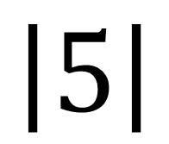

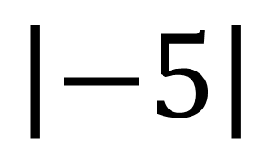
Absolute Value
$$\left|±x\right|=+x$$
EXAMPLES
$$\left|5\right|$$
$$\left|−5\right|$$

Slide 4

Example 1
$\left|x\right|=9$

Slide 5

Example 2
$\left|x\right|+5=16$

Slide 6

Example 3
$4\left|x\right|=32$

Slide 7

Example 4
$7\left|x\right|−14=35$

Slide 8

Example 5
$2\left|x\right|+\left|−4\right|−\left|6\right|=14$

